Slide 1
Organization and Team Structures

Slide 2
Organization structure
Software development involves teamwork.
The members of the team have to coordinate their work, communicate their decisions, etc.
For a small project, the team will consist of up to a few individuals.
As the size of the project increases, so will the team.
Software organizations assign different teams of engineers to handle different software projects.

Slide 3
Functional format vs. project format
Two broad ways in which a software development organization can be structured:
  Functional format
  Project format.

Slide 4
Functional Format
In the functional format, the development staff are divided based on the functional group to which they belong.
The different projects borrow engineers from the required functional groups for specific phases to be undertaken in the project and return them to the functional group upon the completion of the phase.

Slide 5
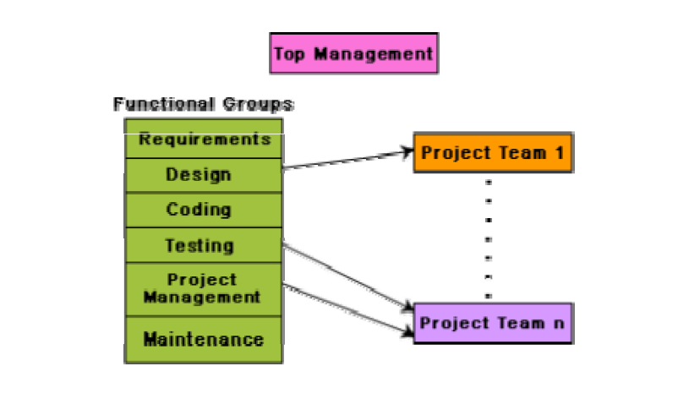
Functional Organization

Slide 6
Functional Format
In the functional format, different teams of programmers perform different phases of a project.
For example, one team might do the requirements specification, another do the design, and so on.
The partially completed product passes from one team to another as the project evolves.

Slide 7
Functional Format
Therefore, the functional format requires considerable communication among the different teams because the work of one team must be clearly understood by the subsequent teams working on the project.
This requires good quality documentation to be produced after every activity

Slide 8
Project Format
In the project format, a set of engineers is assigned to the project at the start of the project and they remain with the project till the completion of the project.
Thus, the same team carries out all the life cycle activities.

Slide 9
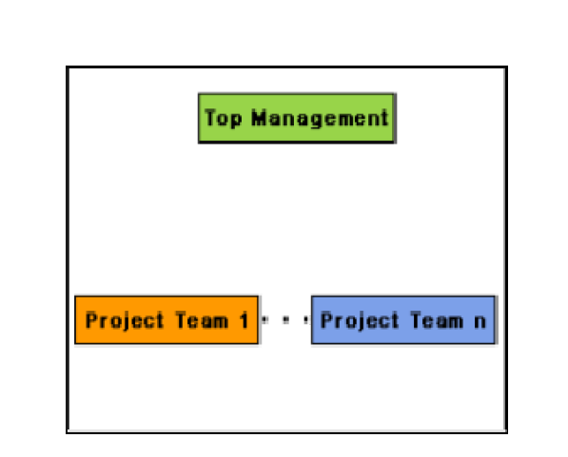
Project Organization

Slide 10
Advantages of functional organization over project organization
Ease of staffing
Production of good quality documents
Job specialization
Efficient handling of the problems associated with manpower turnover.

Slide 11
Disadvantages of functional organization
Requires more communication among teams than the project format, because one team must understand the work done by the previous teams.
not suitable for small organizations handling just one or two projects.

Slide 12
Team structures
There are mainly three formal team structures:
    chief programmer,
    democratic, and
    the mixed team organizations

Slide 13
Chief Programmer Team
A senior engineer provides the technical leadership and is designated as the chief programmer.
The chief programmer partitions the task into small activities and assigns them to the team members.
He also verifies and integrates the products developed by different team members.

Slide 14
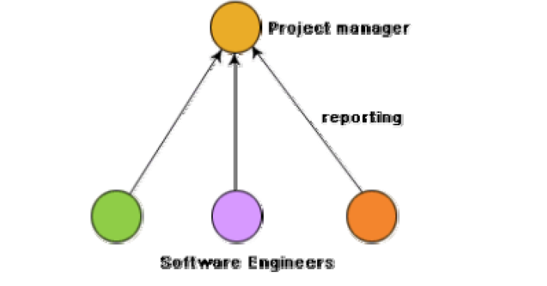
Chief programmer team structure

Slide 15
Chief Programmer Team
The chief programmer team is subject to single point failure since too much responsibility and authority is assigned to the chief programmer.
This is probably the most efficient way of completing simple and small projects since the chief programmer can work out a satisfactory design and ask the programmers to code different modules of his design solution.

Slide 16
Democratic Team
The democratic team structure, as the name implies, does not enforce any formal team hierarchy.
Typically, a manager provides the administrative leadership.
At different times, different members of the group provide technical leadership.

Slide 17
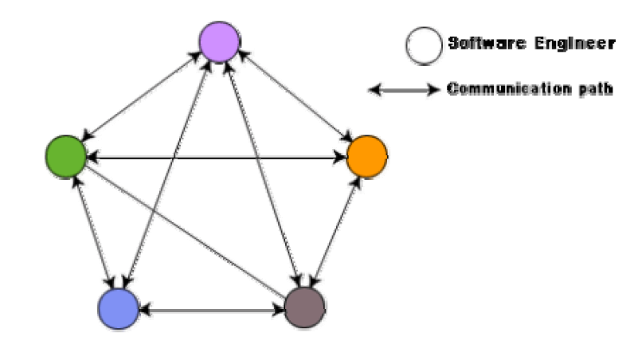
Democratic Team

Slide 18
Democratic Team
appropriate for less understood problems, since a group of engineers can invent better solutions than a single individual as in a chief programmer team.
suitable for projects requiring less than five or six engineers and for research-oriented projects.
encourages egoless programming as programmers can share and review one another’s work .

Slide 19
Mixed Control Team Organization
ideas from both the democratic organization and the chief-programmer organization.
incorporates both hierarchical reporting and democratic set up.
suitable for large team sizes.
The democratic arrangement at the senior engineers level is used to decompose the problem into small parts.
Each democratic setup at the programmer level attempts solution to a single part.

Slide 20
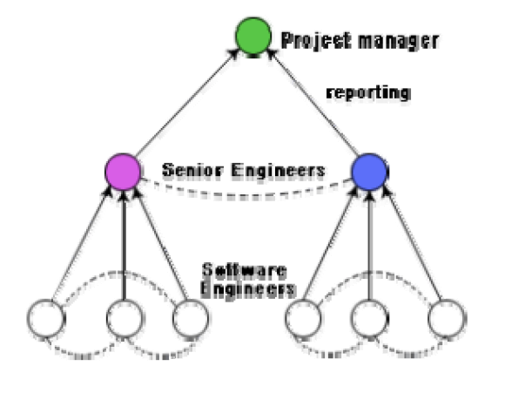
Mixed Control Team Organization
democratic connections are shown as dashed lines and the reporting structure is shown using solid arrows.

Slide 21
Characteristics of a good software engineer
Exposure to systematic techniques, i.e. familiarity with software engineering principles.
Good technical knowledge of the project areas (Domain knowledge).
Good programming abilities.
Good communication skills. These skills comprise of oral, written, and interpersonal skills.
High motivation.
Sound knowledge of fundamentals of computer science.
Intelligence.
Ability to work in a team.
Discipline, etc.

